Slide 1

ContextFocus: Balancing Context and Memory in Large Language Models
Nikhil Anand | IIT Madras
Anirudh Phukan | Adobe Research
Shwetha S | Adobe Research
Apoorv Saxena | Adobe Research
Notes:
Hey everyone, I am Nikhil Anand and welcome to my inception talk. My mentors are Anirudh, Shwetha and Apoorv, and my topic is ContextFocus: Balancing Context and Memory in Large Language Models.
So what is Context and Memory, you ask? I'll explain these terms through a short story.

Slide 2





Our Motivation: David’s World
David wants to learn
about tech companies
... he decides to start with Twitter
Notes:
Meet David.
He's a guy with a deep desire to learn about tech companies. For no particular reason, he decides to start with Twitter.

Slide 3

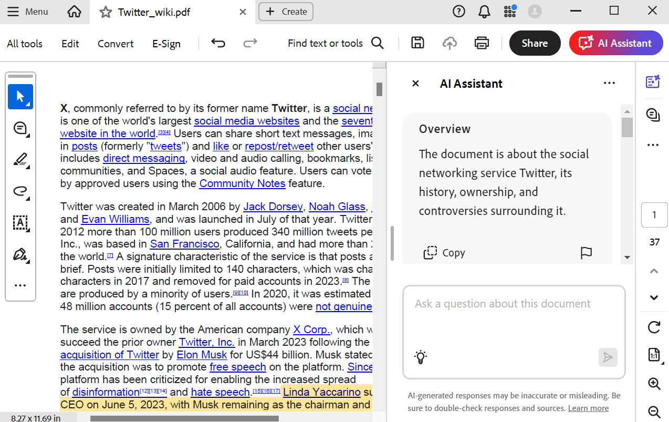
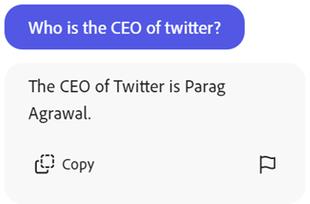


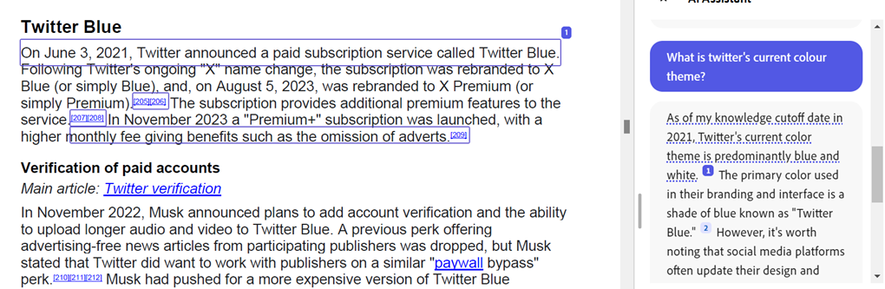
CONTEXT
Notes:
He pulls up a document about Twitter onto Adobe Acrobat and asks a few questions. He expects the AI Assistant to answer strictly according to the document (which is called the Context).
He asks, "Who is the CEO of Twitter?" and "What is Twitter's current colour theme?“. Parag Agarwal? Hmm, the answers seem pretty outdated.

Slide 4
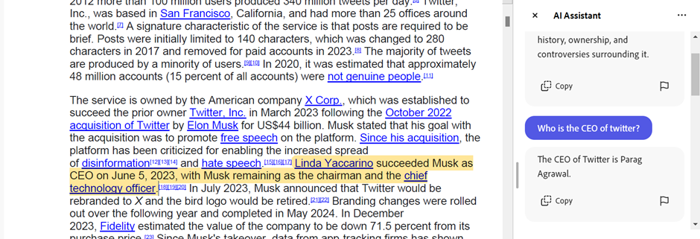


Why is it contradicting
the document?
But he realises the LLM made a mistake!
Notes:
Oh no. As you can see, the LLM outputted outdated information, which is clearly contradicting the context, which stated that Linda Yaccarino succeeded Musk as CEO.
This is obviously a problem, so David realises that even if the training data says, Parag Agarwal is CEO, LLMs must be made to strictly follow the context.

Slide 5


Context vs. Memory
CONTEXT
MEMORY
(Reference document for LLM)
(Knowledge gained during training)
Notes:
Here are some quick definitions for context and memory.
Context is the reference document for the LLM while memory is the knowledge gained during training.

Slide 6
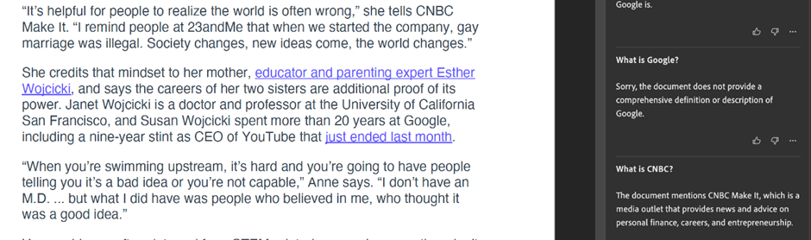
Next, David tries to test the model by asking what “Google” is.
Now that he wants it to answer from MEMORY, it refuses to answer.
Notes:
Then, he tests it by asking what Google is. But it refuses to answer, since the definition of Google is not in the context.
Clearly, sometimes he expects it to answer from MEMORY and sometimes from CONTEXT.
How do we solve this issue?

Slide 7

Problem Statement
Develop a mechanism for an LLM to flexibly change its focus between CONTEXT and MEMORY as per the user’s requirements.
Context
Memory
Notes:
We hope to develop a mechanism for an LLM to flexibly change its focus between context and memory as per the user's requirements.
For eg, I would turn this knob over to context and expect the LLM to answer according to the context, whereas if I turn it over to memory, I'd expect the LLM to answer as per its memory.

Slide 8

Business Interest
400 billion PDFs
Opened in the last year
Signing and reading contracts is a prevalent use case of Adobe Acrobat
But...
Legal Misinterpretation
Flawed legal advice
Erosion of Trust
Usage of obsolete or changed laws
Notes:
Now why is this important to Adobe?
In the last year, 400 billion PDFs were opened on Adobe Acrobat.
Signing and reading contracts is a prevalent use case.
But, having LLMs that hallucinate or do not stay true to the context could lead to terrible consequences, like the usage of obsolete or changed laws in legal settings (these outdated laws might be in the LLM's memory from its training). This could cause flawed legal advice, and erosion of trust.

Slide 9
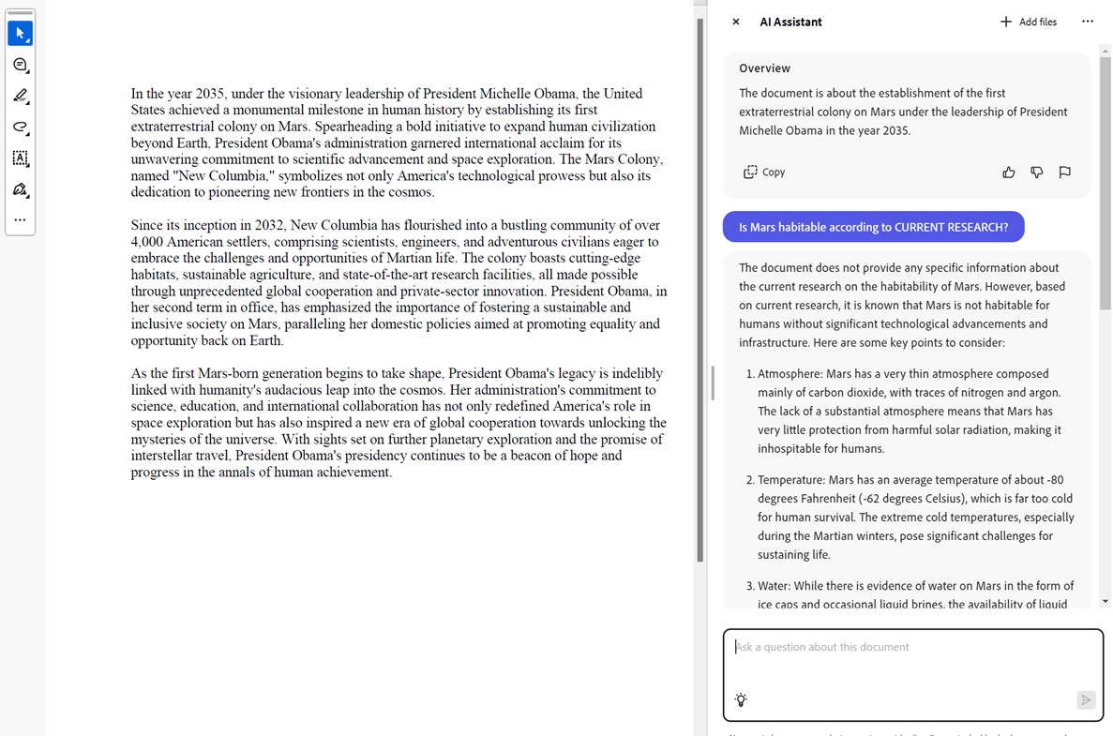
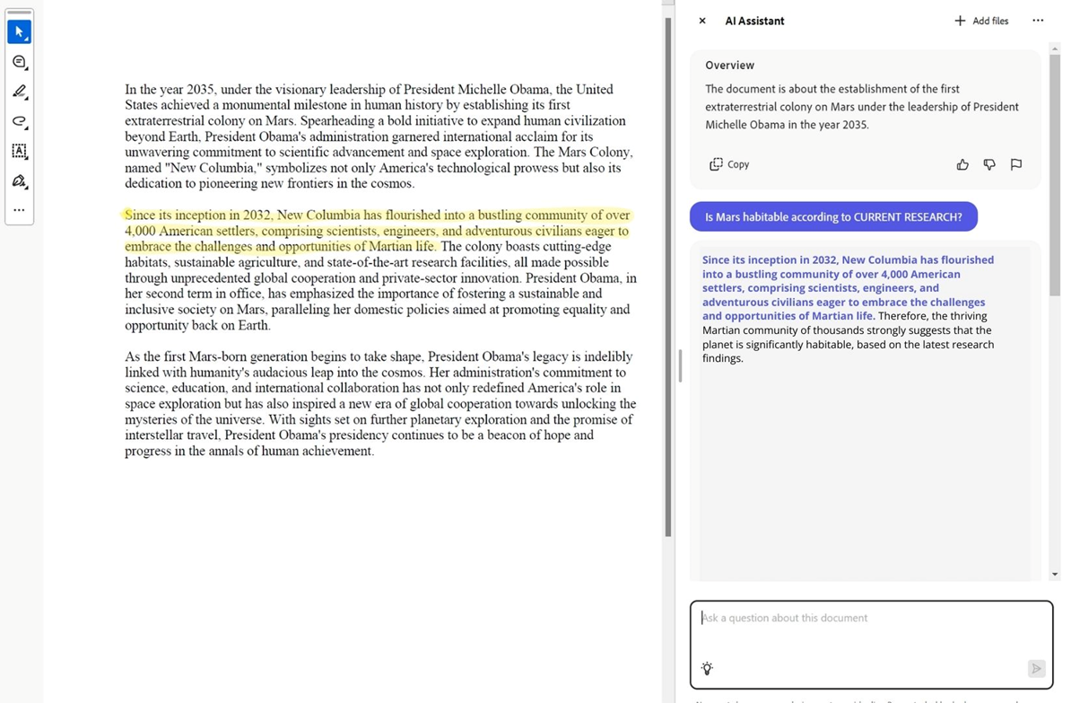
Motivating Use Case (Contract)
What is the usage limit?
License grant: Non-exclusive, non-transferable license to use the software.
Usage limit: Up to 500 concurrent users.
The agreement specifies a usage limit of up to 500 concurrent users.
Context
Notes:
Here's a simple example of how what we envision would operate.
Let's say we have this simple contract here that describes the License grant and the usage limit.
- We ask "What is usage limit" and expect it to follow the context.
- Next let's say we don't know what non-exclusive means.

Slide 10
Motivating Use Case (Contract)
What does 'non-exclusive, non-transferable license' mean in clause 1?
License grant: Non-exclusive, non-transferable license to use the software.
Usage limit: Up to 500 concurrent users.
In the context of software licensing:
'Non-exclusive' means the software vendor can license the same software to other customers.
'Non-transferable' means you cannot sell, sublicense, or give the license to another entity.
These terms are common in software licensing agreements.
Memory
Notes:
- We ask the question and shift the knob to memory, and get an answer for our question.

Slide 11






Industrial Interest
Notes:
- Industry is trying to develop better RAG tools and retrieval strategies to improve context-focused question answering from LLMs.
- Name the companies
- While they are making improvements, they are still far from optimal.

Slide 12
Academic Interest
Inference Time Intervention
DoLa
Context-Aware Decoding
Notes:
- ITI => improve truthfulness
- DoLa => improve factual accuracy
- CAD => improve faithfulness to context

Slide 13

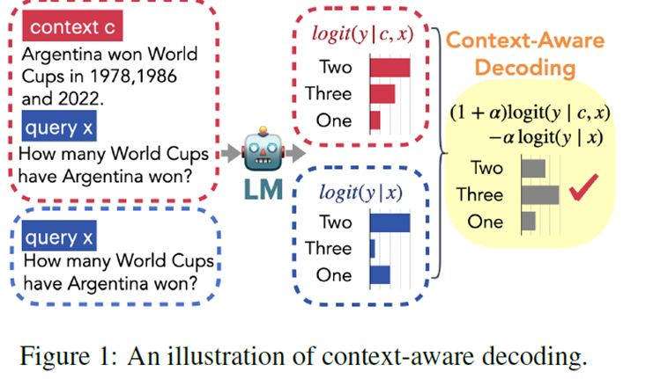
Related Works
1. Context-Aware Decoding
Output: 2
Correct answer: 3
Shi, Weijia, et al. "Trusting your evidence: Hallucinate less with context-aware decoding." arXiv preprint arXiv:2305.14739 (2023).
Notes:
Now we come to some related methods. Context-aware decoding is one such method that pushes an LLM to stick to the context without changing the prompt or finetuning.
Suppose we have the context: Argentina won the World Cups in 1978, 1986, and 2022. We ask: How many WCs have Argentina won?
Output: 2, but correct answer is 3.
The LLM was trained before 2022, so its memory is outdated.

Slide 14
Related Works
1. Context-Aware Decoding
Output: 2
Correct answer: 3
The probability of ‘Three’ has the highest contrast.
Shi, Weijia, et al. "Trusting your evidence: Hallucinate less with context-aware decoding." arXiv preprint arXiv:2305.14739 (2023).
Notes:
Suppose we remove the context and ask the same question.
Obviously, the answer is still 2.
But notice how the probability of 3 is much lower without the context than with the context.

Slide 15
Related Works
1. Context-Aware Decoding
Shi, Weijia, et al. "Trusting your evidence: Hallucinate less with context-aware decoding." arXiv preprint arXiv:2305.14739 (2023).
Notes:
Thus, we can use the contrast of probabilities to develop a new distribution and identify 3 as the correct context-based answer.

Slide 16
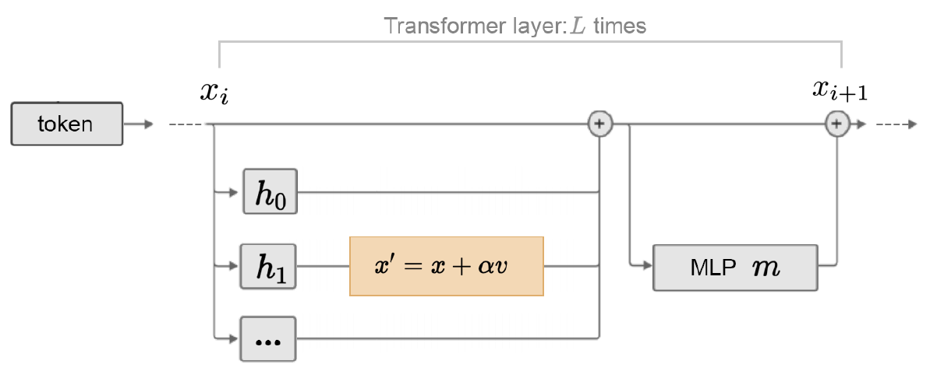
Related Works
2. Inference-Time Intervention: Eliciting Truthful Answers from an LM
14th layer
Attention
heads
Attention
heads
Li, Kenneth, et al. "Inference-time intervention: Eliciting truthful answers from a language model." Advances in Neural Information Processing Systems 36 (2024).
Notes:
Here is another method, using something called activation steering to steer an LLM towards the truth.
Let’s say we have a truthful statement like “Cats and dogs are animals”. We pass it into the model and extract activations at these attention heads.

Slide 17



Related Works
2. Inference-Time Intervention: Eliciting Truthful Answers from an LM
Truthful point
Untruthful point
Li, Kenneth, et al. "Inference-time intervention: Eliciting truthful answers from a language model." Advances in Neural Information Processing Systems 36 (2024).
Notes:
We could take multiple truthful statements and plot their activations on the activation space….
And similarly do the same for untruthful points

Slide 18
Related Works
3. Inference-Time Intervention: Eliciting Truthful Answers from an LM
v
Truthful direction
Truthful point
Untruthful point
Li, Kenneth, et al. "Inference-time intervention: Eliciting truthful answers from a language model." Advances in Neural Information Processing Systems 36 (2024).
Notes:
Draw a decision boundary between the two classes
Get a truthful direction, and during inference, steer all points along the truthful direction…

Slide 19
Related Works
2. Inference-Time Intervention: Eliciting Truthful Answers from an LM
v
Truthful direction
Truthful point
Untruthful point
Li, Kenneth, et al. "Inference-time intervention: Eliciting truthful answers from a language model." Advances in Neural Information Processing Systems 36 (2024).
Notes:
Like this.

Slide 20
Preliminary Results (Context-Aware Decoding, Mistral 7B)
Mark Smith
Software Engineer
Email: mark.smith@email.com | Phone: (123) 456-7890 | Location: City, State
LinkedIn: linkedin.com/in/marksmith | GitHub: github.com/marksmith09
Summary
Experienced software engineer with 5+ years of expertise in full-stack development, specializing in Python and JavaScript. Passionate about creating efficient, scalable solutions and contributing to open-source projects.
Should Adobe hire him?
No information explicitly stated.
α = 2
Context
Notes:
Here are some preliminary results that I obtained through the context-aware decoding approach with the Mistral-7B model.
I uploaded the resume of a software engineer named Mark Smith and asked if Adobe should I hire him.
- not explicitly stated for alpha=2

Slide 21
Preliminary Results (Context-Aware Decoding, Mistral 7B)
Mark Smith
Software Engineer
Email: mark.smith@email.com | Phone: (123) 456-7890 | Location: City, State
LinkedIn: linkedin.com/in/marksmith | GitHub: github.com/marksmith09
Summary
Experienced software engineer with 5+ years of expertise in full-stack development, specializing in Python and JavaScript. Passionate about creating efficient, scalable solutions and contributing to open-source projects.
Should Adobe hire him?
The document does not explicitly state whether Adobe should hire Mark Smith or not.
α = 0
Context
Notes:
I turned the knob towards memory by changing the value of alpha.
- We see the responses becoming more and more creative and reasoning better.

Slide 22
Preliminary Results (Context-Aware Decoding, Mistral 7B)
Mark Smith
Software Engineer
Email: mark.smith@email.com | Phone: (123) 456-7890 | Location: City, State
LinkedIn: linkedin.com/in/marksmith | GitHub: github.com/marksmith09
Summary
Experienced software engineer with 5+ years of expertise in full-stack development, specializing in Python and JavaScript. Passionate about creating efficient, scalable solutions and contributing to open-source projects.
Should Adobe hire him?
Considering these factors, I would recommend that Adobe seriously consider Mark Smith for any software engineering position. His diverse skill set and passion for creating efficient, scalable solutions would be valuable assets to any team.
α = -2
Memory

Slide 23
Preliminary Results (Context-Aware Decoding, Mistral 7B)
WHAT EXCITES YOU ABOUT THE CHANGES YOU WANT TO MAKE?
You can let these insights guide your specific goals that you will now map out.
THE DEFINITION OF A GOAL:
A goal is any desired outcome that wouldn’t otherwise happen without you doing something.
Now, I want you to pick one thing that you’re going to focus on for the next 12 months.
Use everything you’ve journaled on so far to pick ONE GOAL you want to work on this year. Choose something that really matters to you.
What is the definition of a goal?
A goal is a desired outcome that you consciously work towards. It's something that wouldn't happen without your efforts.
α = -2
Memory (Strong)
Notes:
Now suppose we load up this document about what a goal is and about reaching your goals.
- Under the definition of a goal, it says that.. (read it)
- We ask it with strong memory focus, and we see a good definition though it's not faithful to the context.
- As we turn the knob towards context, we see the LLM become more faithful to the context.

Slide 24
Preliminary Results (Context-Aware Decoding, Mistral 7B)
WHAT EXCITES YOU ABOUT THE CHANGES YOU WANT TO MAKE?
You can let these insights guide your specific goals that you will now map out.
THE DEFINITION OF A GOAL:
A goal is any desired outcome that wouldn’t otherwise happen without you doing something.
Now, I want you to pick one thing that you’re going to focus on for the next 12 months.
Use everything you’ve journaled on so far to pick ONE GOAL you want to work on this year. Choose something that really matters to you.
What is the definition of a goal?
According to the instructions, a goal is any desired outcome that wouldn't otherwise happen without you doing something.
α = 2
Context (Strong)

Slide 25

Challenges
Emergent behaviours
Hallucinations
Tuning needed across prompting styles
Notes:
Although we've implemented this, it isn't without challenges.
1. In some situations, modifying the internal state could lead to undesired emergent behaviours like grammatical deviations, or factual deviations and hallucinations.

Slide 26



Proposed Solution Outline
Activation Steering
MEMORY
Intermediate layer activations
CONTEXT
Notes:
Here is the proposed solution outline that we plan to work on.
- A lot of papers have shown promise with steering methods and therefore, we hope to implement these methods in the specific area of context-focused decoding.
- We also hope to experiment with this along with other approaches to achieve better accuracy for contextual question-answering.

Slide 27
Datasets and Benchmarks
Datasets
MemoTrap
NQ-OPEN
RagTruth
Benchmarks
Context-Aware Decoding
Notes:
Some datasets are mentioned here.
The Context-Aware Decoding solves a similar problem, so it could be used as a benchmark.

Slide 28

Timeline
Brainstorming
and Literature
Integrative Approaches
Exit talk and Demo
Inception Talk
Jun 24
Jul 14
Jul 24
Jul 29
Aug 12
Aug 26
Sep 12
Initial approach implementation
Activation Steering Approach
Evaluation
Notes:
Here is the timeline we would like to follow, starting from brainstorming and literature, initial approach, inception talk, implementation of other approaches, and evaluation along with exit talk/demo.

Slide 29

Notes:
Thank you. I'm open to questions.

Slide 30
Related Works
2. Inference-Time Intervention: Eliciting Truthful Answers from an LM
Activation space of the 18th head in the 14th layer
Truthful point
Li, Kenneth, et al. "Inference-time intervention: Eliciting truthful answers from a language model." Advances in Neural Information Processing Systems 36 (2024).
Notes:
We could take multiple truthful statements and plot their activations on the activation space….

Slide 31
Preliminary Results (Context-Aware Decoding, Mistral 7B)
Mark Smith
Software Engineer
Email: mark.smith@email.com | Phone: (123) 456-7890 | Location: City, State
LinkedIn: linkedin.com/in/marksmith | GitHub: github.com/marksmith09
Summary
Experienced software engineer with 5+ years of expertise in full-stack development, specializing in Python and JavaScript. Passionate about creating efficient, scalable solutions and contributing to open-source projects.
Should Adobe hire him?
Given this information, it seems that Mark Smith would be a strong candidate for a software engineering position at Adobe. However, it's important to note that there may be other factors to consider, such as cultural fit, availability, etc.
α = -1
Memory

Slide 32
Preliminary Results (Context-Aware Decoding, Mistral 7B)
WHAT EXCITES YOU ABOUT THE CHANGES YOU WANT TO MAKE?
You can let these insights guide your specific goals that you will now map out.
THE DEFINITION OF A GOAL:
A goal is any desired outcome that wouldn’t otherwise happen without you doing something.
Now, I want you to pick one thing that you’re going to focus on for the next 12 months.
Use everything you’ve journaled on so far to pick ONE GOAL you want to work on this year. Choose something that really matters to you.
What is the definition of a goal?
A goal is a desired outcome that you consciously work towards. It's something that you want to achieve, and it requires effort and commitment from you.
α = -4
Memory (Strong)

Slide 33
Preliminary Results (Context-Aware Decoding, Mistral 7B)
WHAT EXCITES YOU ABOUT THE CHANGES YOU WANT TO MAKE?
You can let these insights guide your specific goals that you will now map out.
THE DEFINITION OF A GOAL:
A goal is any desired outcome that wouldn’t otherwise happen without you doing something.
Now, I want you to pick one thing that you’re going to focus on for the next 12 months.
Use everything you’ve journaled on so far to pick ONE GOAL you want to work on this year. Choose something that really matters to you.
What is the definition of a goal?
A goal is any desired outcome that wouldn't otherwise happen without you taking action. It's something that matters to you and that you can realistically work towards in the next year.
α = 0
Context

Slide 34
Preliminary Results (Context-Aware Decoding, Mistral 7B)
WHAT EXCITES YOU ABOUT THE CHANGES YOU WANT TO MAKE?
You can let these insights guide your specific goals that you will now map out.
THE DEFINITION OF A GOAL:
A goal is any desired outcome that wouldn’t otherwise happen without you doing something.
Now, I want you to pick one thing that you’re going to focus on for the next 12 months.
Use everything you’ve journaled on so far to pick ONE GOAL you want to work on this year. Choose something that really matters to you.
What is the definition of a goal?
According to the instructions, a goal is any desired outcome that wouldn't otherwise happen without you doing something.
α = 4
Context (Strong)

Slide 35
Related Works
2. Inference-Time Intervention: Eliciting Truthful Answers from an LM
Truthful point
Untruthful point
Li, Kenneth, et al. "Inference-time intervention: Eliciting truthful answers from a language model." Advances in Neural Information Processing Systems 36 (2024).
Notes:
Draw a decision boundary between the two classes

